Slide 1
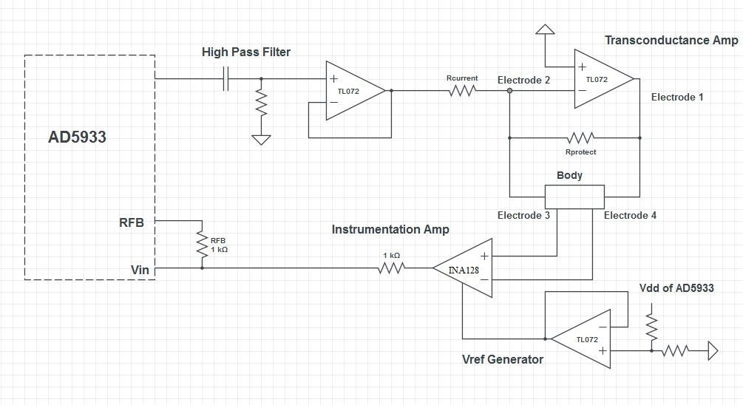
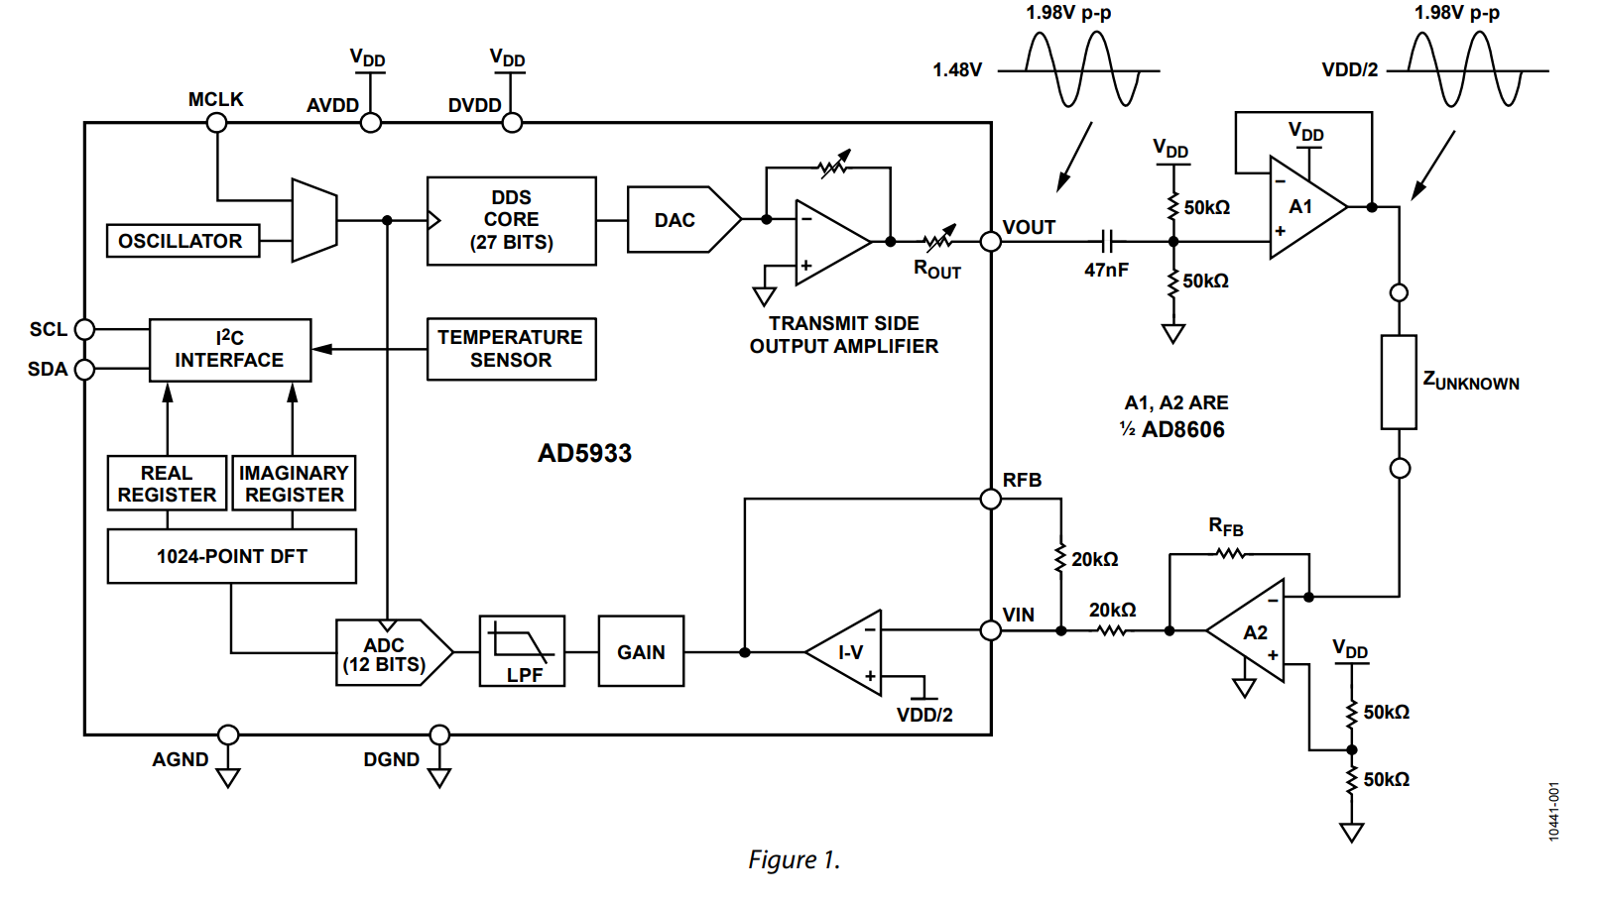
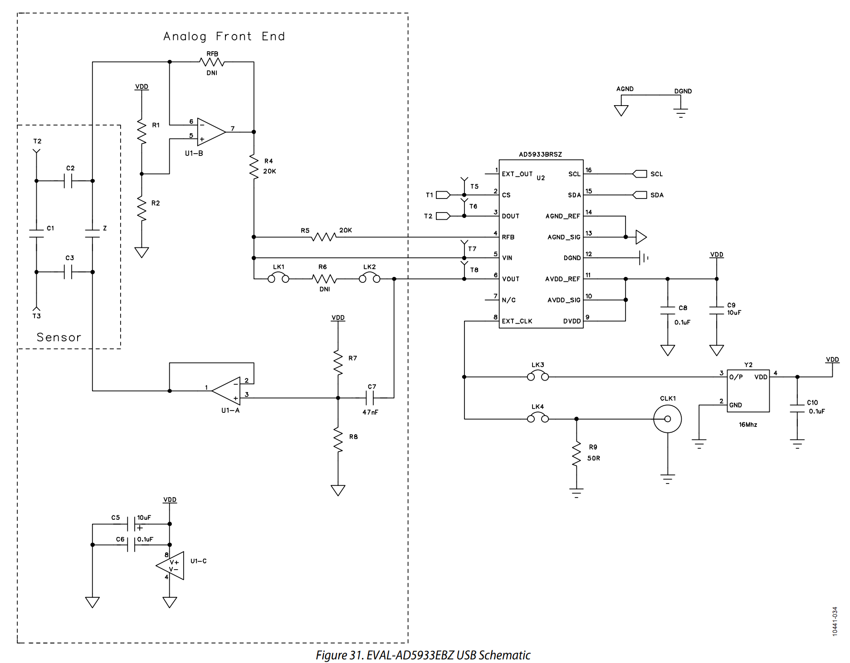
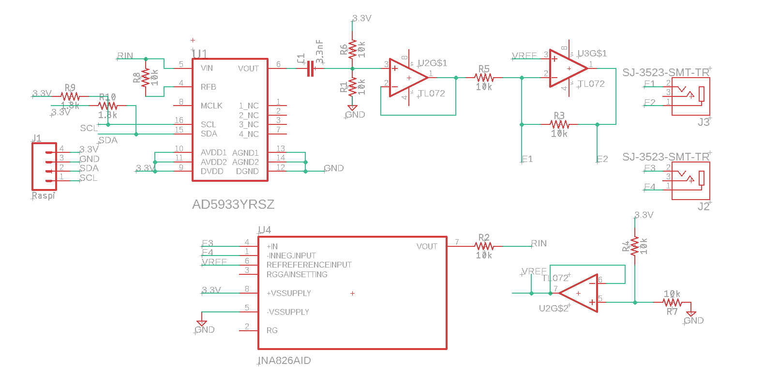
Instructables
Analog Devices Evaluation Board
Analog Devices Evaluation Board
Senior Design 2022

Slide 2
Combined Circuit
AD8606
100k
Changed
Resistors
1M
10nF
100k
200k
3.3V
1K
20k
IN A826
20k
Evaluation Board
Same
Voltage Ref
but with Buffer
GND
By cutting jumpers you can enable
Left or Right circuit
You either have one electrode plug on left side
Or you have two on right side

Slide 3
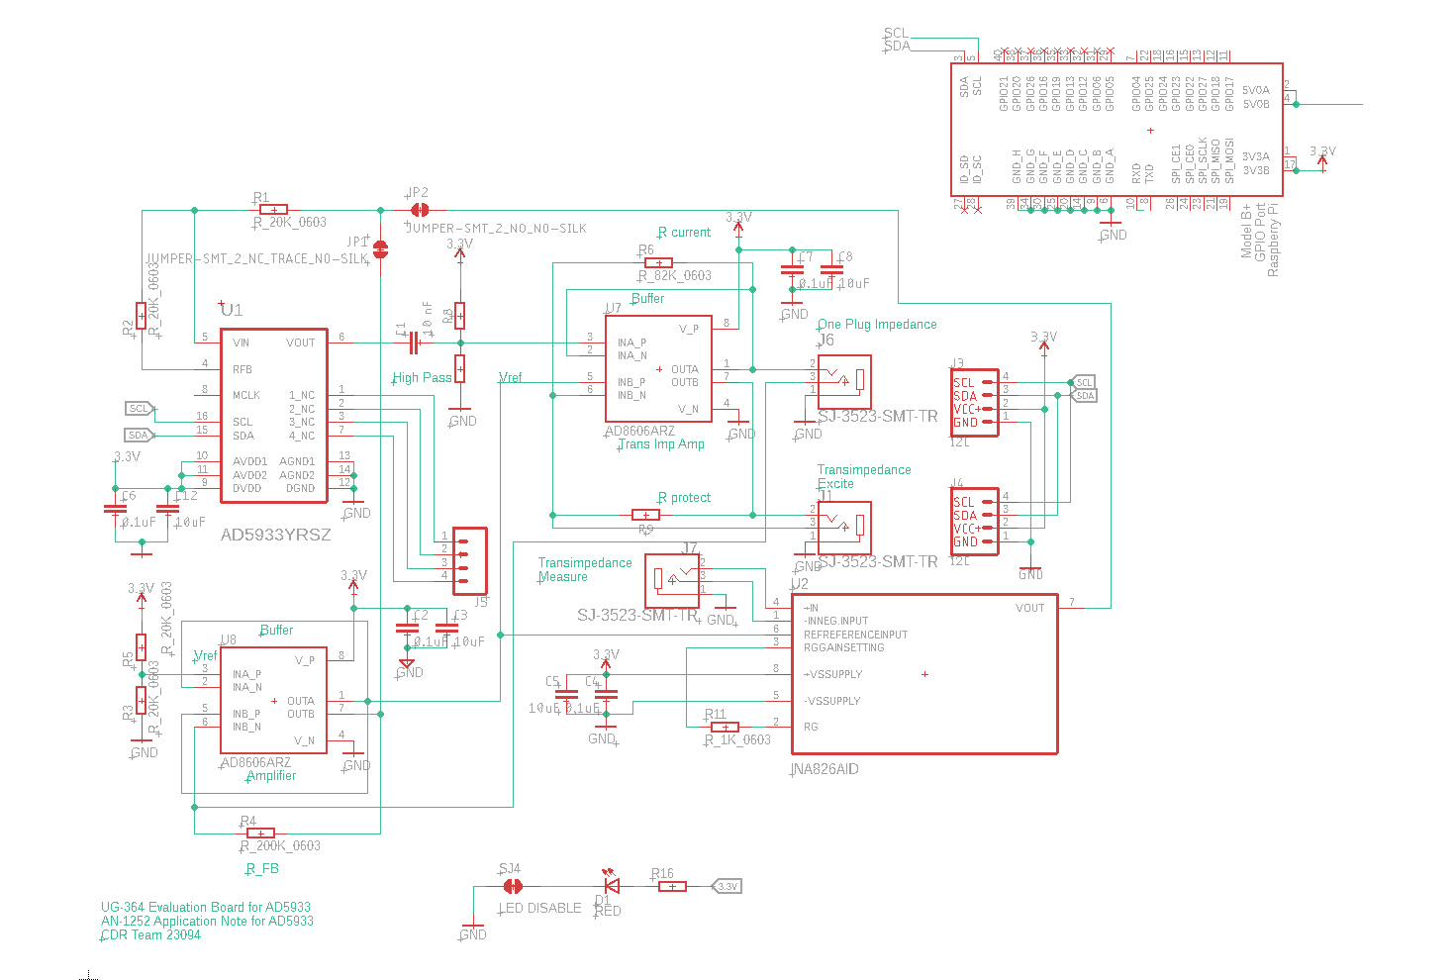

Slide 4
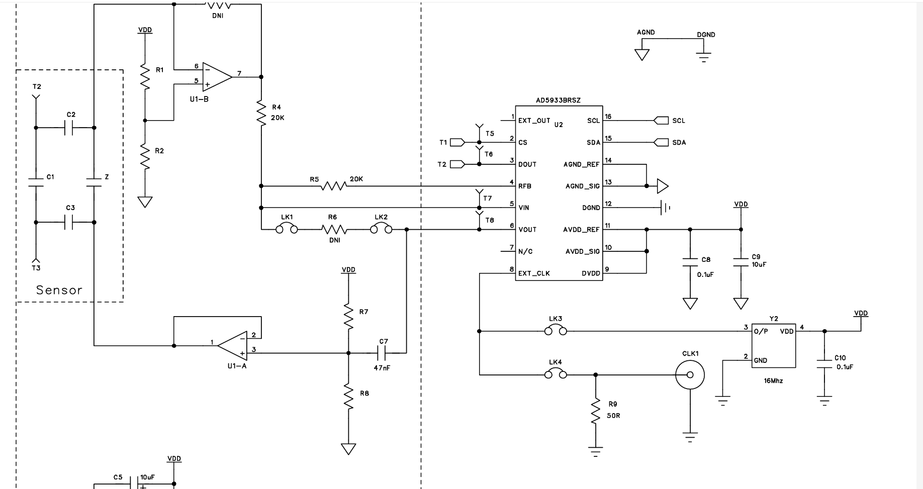
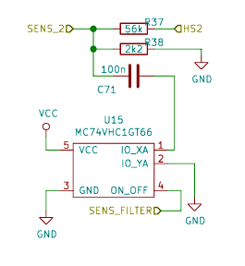

Needs to be added for callibration
If you want LK1 and LK2 controlled digitally you can use analog switch: MC74VHC1GT66
In the example diagram on the right (from an other project),
the capacitor 100nF is connected to ground if SENS_FILTER from
Microcontroller is set high/low.

